Slide 1

Hands Off!
The Modern Cookbook
SG3 Enterprise

Slide 2
Introduction
SG3 Enterprise
Vision & Introductions
Hands Off
Purpose & development process
Demonstration
Questions
Notes:
Company
Who we are
What we aim to do
Product
What our product is
Why it will fit in the market
How it will be developed
Demonstration
Give you a taste of what we will produce
Hold questions

Slide 3
SG3 Enterprise Company Vision
Developing high-quality software
Delivering unique and innovative solutions
Embracing modern technologies & trends
Working together with the client
Notes:
High Quality Software Development
Working with the client
Product Meets Spec
Progress is to clients liking
Through Market Research & Analysis, Products are unique and innovative Embracing current technologies and trends to deliver a product that stands out amongst competition.

Slide 4
Meet the team!
Team Leader
Multimedia & Content Manager
QA & Documentation Manager
Software Manager
Design Manager
GUI Developer
Finance Manager
Marketing Manager
Marco Bolt
Alex Bennett
Alex Fletcher
Jack Rookes
Jérémy Servoz
Kevin Sum
Miranda Lowther
St.John Gilbert

Slide 5
Modern Cooking
Modern culinary trends for 18-30s
Digital over Physical
Mobile
Quick, healthy & exotic
Social Media
Case study: Joe Wicks
Notes:
Digital
Guardian article 11% drop in sales of physical cookbooks in 2014
BBC GoodFood 8M subscribers 2016
12.5M pages hits jan 2017
Mobile
59% of 25-34 cook with phone/tablet handy - McGarry Bowen
31% say that choosing what to cook is least enjoyable part
Quick, healthy & exotic
Modern lives are busy, quick healthy meals to break the monotony
In 2010 30 minute meals sold 735,000 copies in first ten weeks
15 minute meals is still shown
BBC goodfood trends of 2017, tacos, portuguese, sea veg, insects, healthy snacks
Social Media
Rise of social Media
Case Study: Joe Wicks, started in 2014 uploading videos of him cooking and exercise
3rd bestseller of 2016 Lean in 15 972,128 copies sold
2m insta and 2.5 fb likes
Why confine yourself to a 50 recipe cookbook?

Slide 6
Competition
Notes:
App store is littered with cooking apps
Very few have mostly great reviews
Some problems include charges/pricing and paying for free things
Popular ones are simple,elegant and include huge arrays of recipes and demonstration video
A lot of websites focus on a particular style of cooking or just don't offer enough
Few targeting young people, those that did look unprofessional and are not challenging enough
Basic features and recipes, can’t save etc no shopping lists
Did include nutrition
All are hands on, screen must be on web page always, scroll through steps, M and S had a slide show but still required sliding

Slide 7
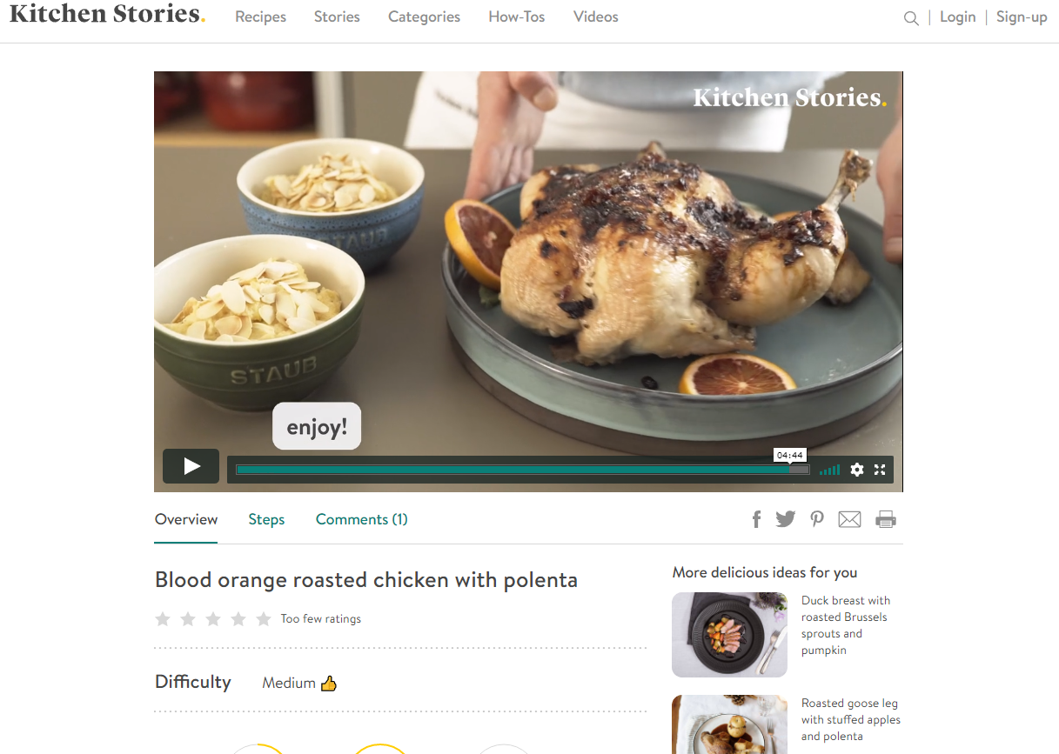
Competition
Notes:
App store is littered with cooking apps
Very few have mostly great reviews
Some problems include charges/pricing and paying for free things
Popular ones are simple,elegant and include huge arrays of recipes and demonstration video
A lot of websites focus on a particular style of cooking or just don't offer enough
Few targeting young people, those that did look unprofessional and are not challenging enough
Basic features and recipes, can’t save etc no shopping lists
Did include nutrition
All are hands on, screen must be on web page always, scroll through steps, M and S had a slide show but still required sliding

Slide 8
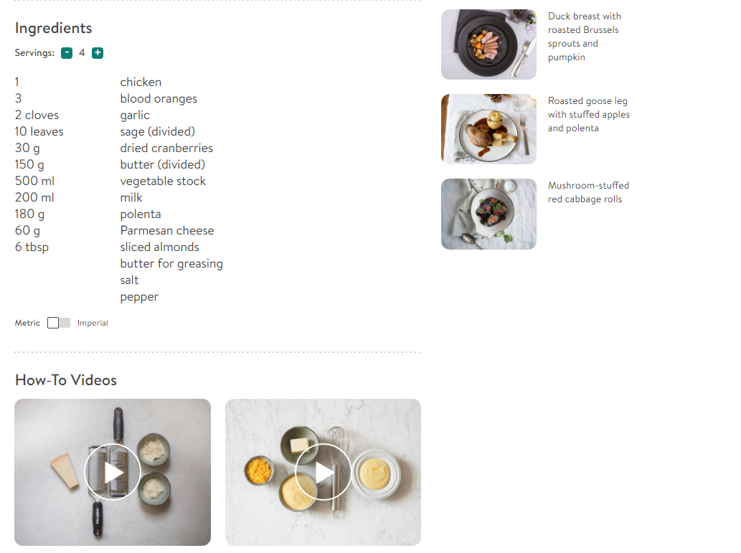
Competition
Notes:
App store is littered with cooking apps
Very few have mostly great reviews
Some problems include charges/pricing and paying for free things
Popular ones are simple,elegant and include huge arrays of recipes and demonstration video
A lot of websites focus on a particular style of cooking or just don't offer enough
Few targeting young people, those that did look unprofessional and are not challenging enough
Basic features and recipes, can’t save etc no shopping lists
Did include nutrition
All are hands on, screen must be on web page always, scroll through steps, M and S had a slide show but still required sliding

Slide 9
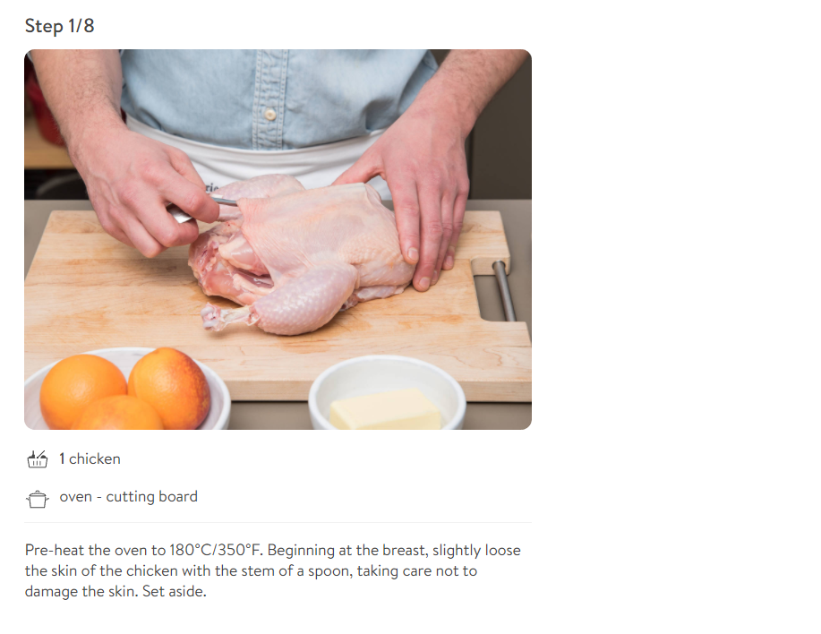
Competition
Notes:
App store is littered with cooking apps
Very few have mostly great reviews
Some problems include charges/pricing and paying for free things
Popular ones are simple,elegant and include huge arrays of recipes and demonstration video
A lot of websites focus on a particular style of cooking or just don't offer enough
Few targeting young people, those that did look unprofessional and are not challenging enough
Basic features and recipes, can’t save etc no shopping lists
Did include nutrition
All are hands on, screen must be on web page always, scroll through steps, M and S had a slide show but still required sliding

Slide 10
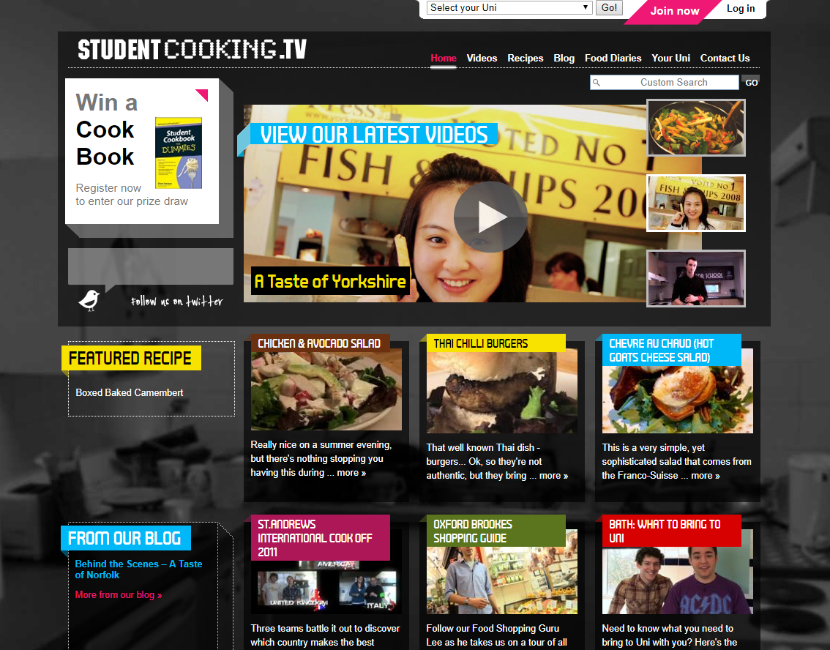
Competition
Notes:
App store is littered with cooking apps
Very few have mostly great reviews
Some problems include charges/pricing and paying for free things
Popular ones are simple,elegant and include huge arrays of recipes and demonstration video
A lot of websites focus on a particular style of cooking or just don't offer enough
Few targeting young people, those that did look unprofessional and are not challenging enough
Basic features and recipes, can’t save etc no shopping lists
Did include nutrition
All are hands on, screen must be on web page always, scroll through steps, M and S had a slide show but still required sliding

Slide 11
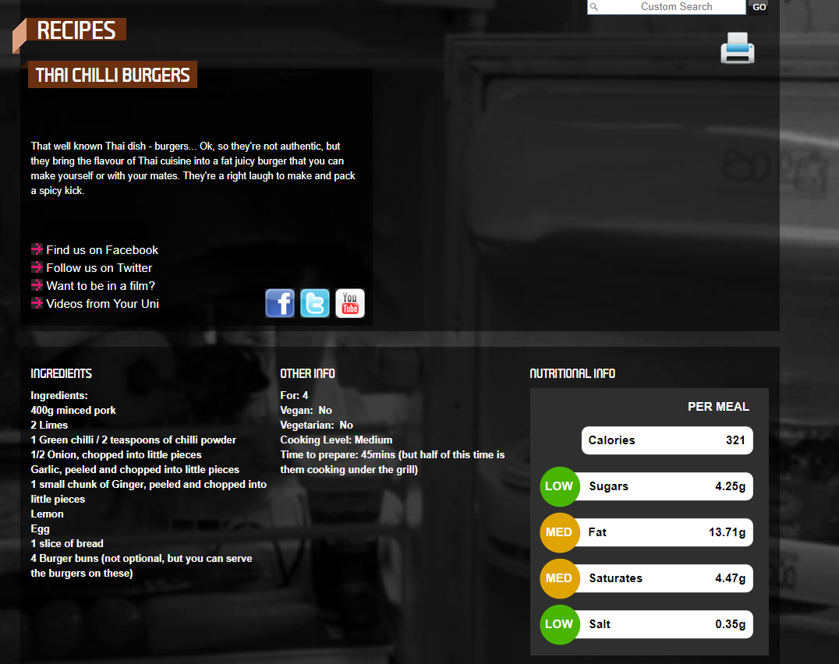
Competition
Notes:
App store is littered with cooking apps
Very few have mostly great reviews
Some problems include charges/pricing and paying for free things
Popular ones are simple,elegant and include huge arrays of recipes and demonstration video
A lot of websites focus on a particular style of cooking or just don't offer enough
Few targeting young people, those that did look unprofessional and are not challenging enough
Basic features and recipes, can’t save etc no shopping lists
Did include nutrition
All are hands on, screen must be on web page always, scroll through steps, M and S had a slide show but still required sliding

Slide 12
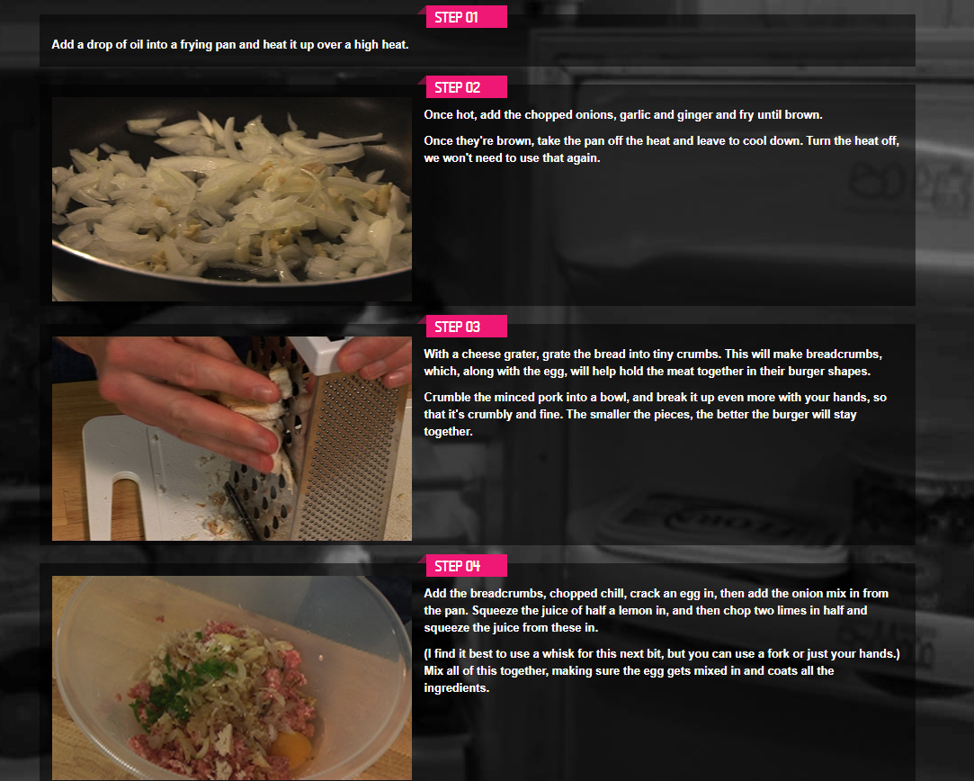
Competition
Notes:
App store is littered with cooking apps
Very few have mostly great reviews
Some problems include charges/pricing and paying for free things
Popular ones are simple,elegant and include huge arrays of recipes and demonstration video
A lot of websites focus on a particular style of cooking or just don't offer enough
Few targeting young people, those that did look unprofessional and are not challenging enough
Basic features and recipes, can’t save etc no shopping lists
Did include nutrition
All are hands on, screen must be on web page always, scroll through steps, M and S had a slide show but still required sliding

Slide 13
Our Demographic:18-30
Tight budgets, exotic tastes
All about mobile
Generation impatient
Global community
Knowledge is power
Online streaming
Notes:
18-30
Biggest savers - HSBC in 2014 , £400/month disposable income
ONS 8.6 million 20-29
18-19 - £11,000
20-24 - £15,000
25-30 - £20,000
Millennials prefer experiences that high ticket items - Forbes
Exotic tastes driven by health conscious - refer back to trends of 2017
Supermarkets stocking more products from further afield
Avocado, quinoa etc
All about mobile -
comscore (measure audiences, advertising, consumer behaviour) 1 hr + facebook per day, 3.4 hrs on apps and 34+ hours per month on fb and insta alone
Most youngsters shop on mobiles/ tablets - wish for simpler payment
Mobile extremes
Generation impatient
Instant gratification, feedback and success
Competitions, discounts and giveaways
Gone are the days of waiting for information - streaming, ordering online and click and collect
Instantaneous communication
Global community
Engage and connect with people globally
Push for sharing/ online community
Knowledge is power
Concerned with real people and experiences
Want to learn and enjoys the challenge
Online streaming
Statista - Spotify 34.5% 16-24 year olds have a premium account
Makes up 36% of all premium account holders of which there are 70M
Netflix - 58% 16-24 and 51% of 25-34
ONS -53% 16-24 and 46% of 25-34

Slide 14
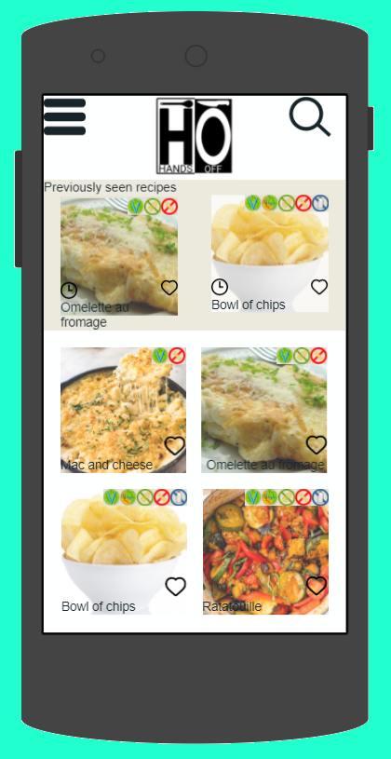
Introducing: Hands Off
Create, discover and share recipes
Large collection of recipes
Easy to use, powerful functionality
Minimal interaction
Minimal screen contact
Minimal fuss.

Slide 15
Marketing Strategy
Target Freshers
Advertising - social media
App Store Optimisation
Notes:
Target freshers
Freshers fairs, uni sponsoring ?
Be present at universities signs, events etc
Advertising
Already seen how engrossed younger people are in social media
Google advertising
App Store Optimisation
Keywords -relevance to cooking
Description - first 2-3 line of description give user enough to make them want to read on
Attractive icon and screenshots of the app being used

Slide 16
Finance-Costs and Loan
Estimated loan
Costs:
Overheads
Code contracts
Wages

Slide 17
Our Business Model
Based upon Freemium business model.
Two versions of app:
Free
Subscription
Notes:
Freemium:
+ve’s
Network effect-more people use it, the more valuable it becomes.
Will need a product/sevice whose value to users increases with time
Keeps costs low
-ve’s
Need lots of users!!!!!!!!!!!!!!! CRUCIAL
Takes a long time to be profitable.
THEREFORE THE ADS/POPUPS
Eg’s:
Evernote, Skype, LinkedIn, Dropbox

Slide 18
Our Business Model
Characteristics of freemium:
Large free user base.
Low cost per user.
Increase value over time.

Slide 19
Design Philosophy
Customer First
Agile Methodology
Flexible development
Cost Effective
High Quality Product
Self-Assessment on QA Metrics
Notes:
After major deadlines the QA manager will lead self-assessed reports, how they feel it’s going and what could be changed. These points will be addressed to the group.

Slide 20
Demonstration

